Slide 1
Rixasvo Wigyvmxc
Hv. Wlippd Lippiv
wlippiv@kay.ihy

Slide 2
Chapter 7: Network security
Foundations:
what is security?
cryptography
authentication
message integrity
key distribution and certification
Security in practice:
application layer: secure e-mail
transport layer: Internet commerce, SSL, SET
network layer: IP security

Slide 3
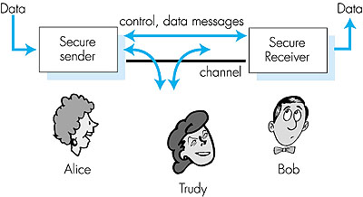
Friends and enemies: Alice, Bob, Trudy
Figure 7.1 goes here
well-known in network security world
Bob, Alice want to communicate “securely”
Trudy, the “intruder” may intercept, delete, add messages

Slide 4
Security Requirements
Confidentiality
Integrity
Availability
Authenticity

Slide 5
What is network security?
Secrecy: only sender, intended receiver should “understand” msg contents
  sender encrypts msg
  receiver decrypts msg
Authentication: sender, receiver want to confirm identity of each other
Message Integrity: sender, receiver want to ensure message not altered (in transit, or afterwards) without detection

Slide 6
Passive Attacks RFC 2828
Eavesdropping on transmissions
To obtain information
Release of message contents
  Outsider learns content of transmission
Traffic analysis
  By monitoring frequency and length of messages, even encrypted, nature of communication may be guessed
Difficult to detect
Can be prevented

Slide 7
Active Attacks
Masquerade
  Pretending to be a different entity
Replay
Modification of messages
Denial of service
Easy to detect
  Detection may lead to deterrent
Hard to prevent

Slide 8

Internet security threats
Packet sniffing:
  broadcast media
  promiscuous NIC reads all packets passing by
  can read all unencrypted data (e.g. passwords)
  e.g.: C sniffs B’s packets
A
C
src:B dest:A payload
B

Slide 9
How Sniffing Works
IP Addresses
  Alice’s IP addr: 10.0.0.23
  Bob’s IP addr: 192.168.100.54
Packet traverses the Internet, from router-to-router. Therefore, Alice must first hand off the packet to the first router. Each router along the way will examine the destination IP address (192.168.100.54) and decide the correct path it should take.
Alice knows the local connection to the first router, and Bob's eventual IP address. Alice uses the Ethernet to do so to send packet.
Ethernet cards have a filter that prevents the host machine from seeing traffic addressed to other stations. Sniffing programs turn off the filter, and thus see everyones’ traffic.
Notes:
Switch technology can prevent sniffing

Slide 10
Internet security threats
IP Spoofing:
  can generate “raw” IP packets directly from application, putting any value into IP source address field
  receiver can’t tell if source is spoofed
  e.g.: C pretends to be B
A
C
src:B dest:A payload
B

Slide 11
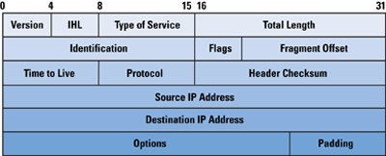
IP Address
Transport layer does NOT check validity of IP address
Hping (for example) lets you craft any address

Slide 12
Internet security threats
Denial of service (DOS):
  flood of maliciously generated packets “swamp” receiver
  Distributed DOS (DDOS): multiple coordinated sources swamp receiver
  e.g., C and remote host SYN-attack A
A
C
SYN
SYN
SYN
SYN
SYN
B
SYN
SYN

Slide 13
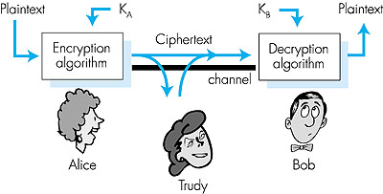
The language of cryptography
plaintext
K
K
plaintext
A
B
ciphertext
Figure 7.3 goes here
symmetric key crypto: sender, receiver keys identical
public-key crypto: encrypt key public, decrypt key secret

Slide 14
Symmetric key cryptography
substitution cipher: substituting one thing for another
  monoalphabetic cipher: substitute one letter for another
plaintext: abcdefghijklmnopqrstuvwxyz
ciphertext: mnbvcxzasdfghjklpoiuytrewq
E.g.:
Plaintext: bob. i love you. alice
ciphertext: nkn. s gktc wky. mgsbc
Q: How hard to break this simple cipher?:
  brute force (how hard?)
  other?

Slide 15
Symmetric key crypto: DES
DES: Data Encryption Standard
US encryption standard [NIST 1993]
56-bit symmetric key, 64 bit plaintext input
How secure is DES?
  DES Challenge: 56-bit-key-encrypted phrase (“Strong cryptography makes the world a safer place”) decrypted (brute force) in 4 months
  no known “backdoor” decryption approach
making DES more secure
  use three keys sequentially (3-DES) on each datum
  use cipher-block chaining

Slide 16

Symmetric key crypto: DES
DES operation
initial permutation
16 identical “rounds” of function application, each using different 48 bits of key
final permutation

Slide 17
Public Key Cryptography
symmetric key crypto
requires sender, receiver know shared secret key
Q: how to agree on key in first place (particularly if never “met”)?
public key cryptography
radically different approach [Diffie-Hellman76, RSA78]
sender, receiver do not share secret key
encryption key public (known to all)
decryption key private (known only to receiver)

Slide 18
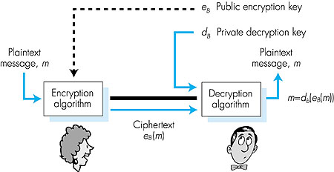
Public key cryptography
Figure 7.7 goes here

Slide 19
Public key encryption algorithms
Two inter-related requirements:
.
.
1
need d ( ) and e ( ) such that
B
B
d (e (m)) = m
B
B
encrypt
decrypt
2
need public and private keys
for d ( ) and e ( )
.
.
B
B
RSA: Rivest, Shamir, Adelson algorithm

Slide 20
RSA: Choosing keys
1. Choose two large prime numbers p, q.
(e.g., 1024 bits)
2. Compute n = pq, z = (p-1)(q-1)
3. Choose e (with e<n) that has no common factors
with z. (e, z are “relatively prime”).
4. Choose d such that ed-1 is exactly divisible by z.
(in other words: ed mod z = 1 ).
5. Public key is (n,e). Private key is (n,d).

Slide 21
RSA: Encryption, decryption
0. Given (n,e) and (n,d) as computed above
1. To encrypt bit pattern, m, compute
e
e
c = m mod n
(i.e., remainder when m is divided by n)
2. To decrypt received bit pattern, c, compute
d
d
m = c mod n
(i.e., remainder when c is divided by n)
Magic
happens!
e
d
m = (m mod n)
mod n

Slide 22
RSA example:
Bob chooses p=5, q=7. Then n=35, z=24.
e=5 (so e, z relatively prime).
d=29 (so ed-1 exactly divisible by z.
m
e
e
letter
m
c = m mod n
encrypt:
l
12
1524832
17
d
d
c
c
m = c mod n
letter
decrypt:
17
481968572106750915091411825223072000
12
l

Slide 23
RSA: Why:
e
d
m = (m mod n)
mod n
Number theory result: If p,q prime, n = pq, then
y
y mod (p-1)(q-1)
x mod n = x mod n
e
d
ed
(m mod n)
mod n = m mod n
ed mod (p-1)(q-1)
= m mod n
(using number theory result above)
1
= m mod n
(since we chose ed to be divisible by
(p-1)(q-1) with remainder 1 )
= m

Slide 24
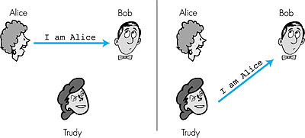
Authentication
Goal: Bob wants Alice to “prove” her identity to him
Protocol ap1.0: Alice says “I am Alice”
Failure scenario??

Slide 25
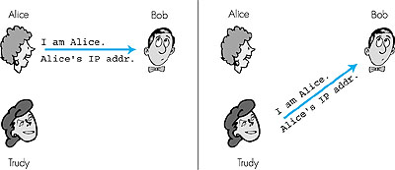
Authentication: another try
Protocol ap2.0: Alice says “I am Alice” and sends her IP
address along to “prove” it.
Failure scenario??

Slide 26
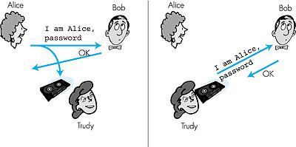
Authentication: another try
Protocol ap3.0: Alice says “I am Alice” and sends her
secret password to “prove” it.
Failure scenario?

Slide 27
Authentication: yet another try
Protocol ap3.1: Alice says “I am Alice” and sends her
encrypted secret password to “prove” it.
I am Alice
encrypt(password)
Failure scenario?

Slide 28

Authentication: yet another try
Goal: avoid playback attack
Nonce: number (R) used only once in a lifetime
ap4.0: to prove Alice “live”, Bob sends Alice nonce, R. Alice
must return R, encrypted with shared secret key
Figure 7.11 goes here
Failures, drawbacks?

Slide 29
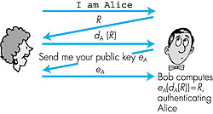
Authentication: ap5.0
ap4.0 requires shared symmetric key
  problem: how do Bob, Alice agree on key
  can we authenticate using public key techniques?
ap5.0: use nonce, public key cryptography
Figure 7.12 goes here

Slide 30
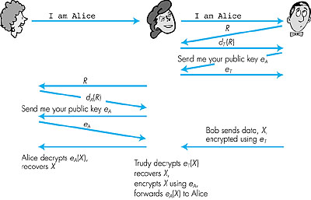
ap5.0: security hole
Man (woman) in the middle attack: Trudy poses as Alice (to Bob) and as Bob (to Alice)
Figure 7.14 goes here
Need “certified” public
keys (more later …)

Slide 31
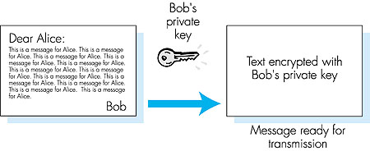
Digital Signatures
Cryptographic technique analogous to hand-written signatures.
Sender (Bob) digitally signs document, establishing he is document owner/creator.
Verifiable, nonforgeable: recipient (Alice) can verify that Bob, and no one else, signed document.
Simple digital signature for message m:
Bob encrypts m with his public key d_{B}, creating signed message, d_{B}(m).
Bob sends m and d_{B}(m) to Alice.

Slide 32
Digital Signatures (more)
Suppose Alice receives msg m, and digital signature d_{B}(m)
Alice verifies m signed by Bob by applying Bob’s public key e_{B} to d_{B}(m) then checks e_{B}(d_{B}(m) ) = m.
If e_{B}(d_{B}(m) ) = m, whoever signed m must have used Bob’s private key.
Alice thus verifies that:
  Bob signed m.
  No one else signed m.
  Bob signed m and not m’.
Non-repudiation:
  Alice can take m, and signature d_{B}(m) to court and prove that Bob signed m.

Slide 33
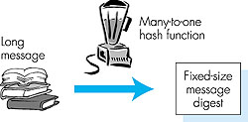
Message Digests
Computationally expensive to public-key-encrypt long messages
Goal: fixed-length,easy to compute digital signature, “fingerprint”
apply hash function H to m, get fixed size message digest, H(m).
Hash function properties:
Many-to-1
Produces fixed-size msg digest (fingerprint)
Given message digest x, computationally infeasible to find m such that x = H(m)
computationally infeasible to find any two messages m and m’ such that H(m) = H(m’).

Slide 34
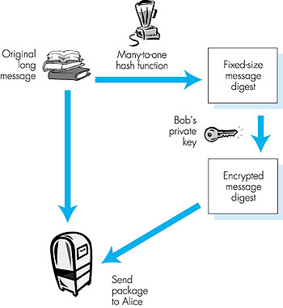
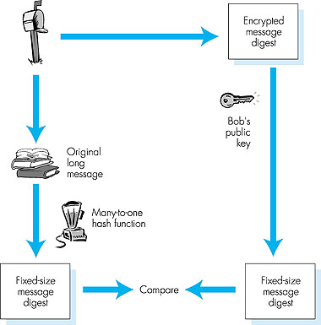
Digital signature = Signed message digest
Bob sends digitally signed message:
Alice verifies signature and integrity of digitally signed message:

Slide 35
Hash Function Algorithms
Internet checksum would make a poor message digest.
  Too easy to find two messages with same checksum.
MD5 hash function widely used.
  Computes 128-bit message digest in 4-step process.
  arbitrary 128-bit string x, appears difficult to construct msg m whose MD5 hash is equal to x.
SHA-1 is also used.
  US standard
  160-bit message digest

Slide 36
Trusted Intermediaries
Problem:
  How do two entities establish shared secret key over network?
Solution:
  trusted key distribution center (KDC) acting as intermediary between entities
Problem:
  When Alice obtains Bob’s public key (from web site, e-mail, diskette), how does she know it is Bob’s public key, not Trudy’s?
Solution:
  trusted certification authority (CA)

Slide 37
Automatic Key Distribution
Session Key
  Used for duration of one logical connection
  Destroyed at end of session
  Used for user data
Permanent key
  Used for distribution of keys
Key distribution center
  Determines which systems may communicate
  Provides one session key for that connection
Security service module (SSM)
  Performs end to end encryption
  Obtains keys for host

Slide 38
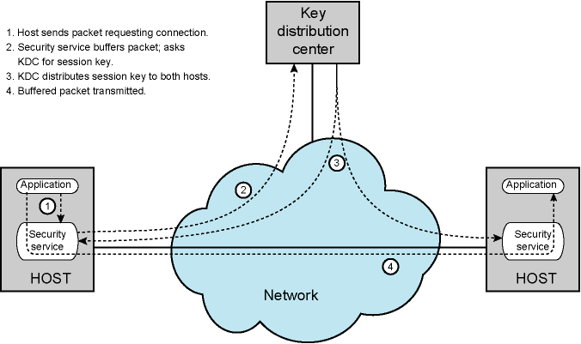
Automatic Key Distribution for Connection-Oriented Protocols

Slide 39
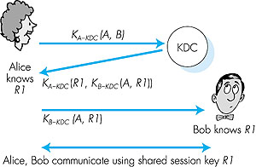
Key Distribution Center (KDC)
Alice,Bob need shared symmetric key.
KDC: server shares different secret key with each registered user.
Alice, Bob know own symmetric keys, K_{A-KDC} K_{B-KDC} , for communicating with KDC.
Alice communicates with KDC, gets session key R1, and K_{B-KDC}(A,R1)
Alice sends Bob
K_{B-KDC}(A,R1), Bob extracts R1
Alice, Bob now share the symmetric key R1.

Slide 40
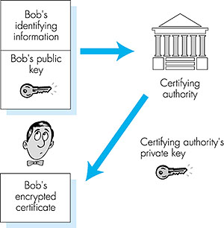
Certification Authorities
Certification authority (CA) binds public key to particular entity.
Entity (person, router, etc.) can register its public key with CA.
  Entity provides “proof of identity” to CA.
  CA creates certificate binding entity to public key.
  Certificate digitally signed by CA.
When Alice wants Bob’s public key:
gets Bob’s certificate (Bob or elsewhere).
Apply CA’s public key to Bob’s certificate, get Bob’s public key

Slide 41
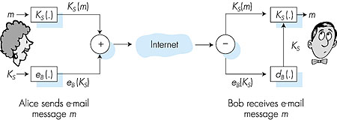
Secure e-mail
Alice wants to send secret e-mail message, m, to Bob.
generates random symmetric private key, K_{S}.
encrypts message with K_{S}
also encrypts K_{S} with Bob’s public key.
sends both K_{S}(m) and e_{B}(K_{S}) to Bob.

Slide 42
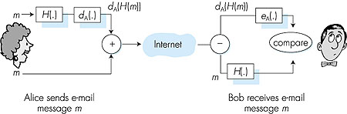
Secure e-mail (continued)
Alice wants to provide sender authentication message integrity.
Alice digitally signs message.
sends both message (in the clear) and digital signature.

Slide 43
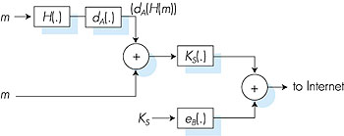
Secure e-mail (continued)
Alice wants to provide secrecy, sender authentication,
message integrity.
Note: Alice uses both her private key, Bob’s public key.

Slide 44
Pretty good privacy (PGP)
Internet e-mail encryption scheme, a de-facto standard.
Uses symmetric key cryptography, public key cryptography, hash function, and digital signature as described.
Provides secrecy, sender authentication, integrity.
Inventor, Phil Zimmerman, was target of 3-year federal investigation. 1991
A PGP signed message:
---BEGIN PGP SIGNED MESSAGE---
Hash: SHA1
Bob:My husband is out of town tonight.Passionately yours, Alice
---BEGIN PGP SIGNATURE---
Version: PGP 5.0
Charset: noconv
yhHJRHhGJGhgg/12EpJ+lo8gE4vB3mqJhFEvZP9t6n7G6m5Gw2
---END PGP SIGNATURE---

Slide 45
End to End Encryption
Encryption done at ends of system
Data in encrypted form crosses network unaltered
Destination shares key with source to decrypt
Host can only encrypt user data
  Otherwise switching nodes could not read header or route packet
Traffic pattern not secure
Use both link and end to end

Slide 46
Link Encryption
Each communication link equipped at both ends
All traffic secure
High level of security
Requires lots of encryption devices
Message must be decrypted at each switch to read address (virtual circuit number)
Security vulnerable at switches
  Particularly on public switched network

Slide 47
Secure sockets layer (SSL)
PGP provides security for a specific network app.
SSL works at transport layer. Provides security to any TCP-based app using SSL services.
SSL: used between WWW browsers, servers for Internet commerce (shttp).
SSL security services:
  server authentication
  data encryption
  client authentication (optional)
Server authentication:
  SSL-enabled browser includes public keys for trusted CAs.
  Browser requests server certificate, issued by trusted CA.
  Browser uses CA’s public key to extract server’s public key from certificate.
Visit your browser’s security menu to see its trusted CAs.

Slide 48
Secure Sockets Layer
Transport Layer Security
Security services
Transport Layer Security defined in RFC 2246
SSL general-purpose service
  Set of protocols that rely on TCP
Two implementation options
  Part of underlying protocol suite
    Transparent to applications
  Embedded in specific packages
    E.g. Netscape and Microsoft Explorer and most Web servers
Minor differences between SSLv3 and TLS

Slide 49
SSL (continued)
Encrypted SSL session:
Browser generates symmetric session key, encrypts it with server’s public key, sends encrypted key to server.
Using its private key, server decrypts session key.
Browser, server agree that future msgs will be encrypted.
All data sent into TCP socket (by client or server) is encrypted with session key.
SSL: basis of IETF Transport Layer Security (TLS).
SSL can be used for non-Web applications, e.g., IMAP.
Client authentication can be done with client certificates.

Slide 50
Secure electronic transactions (SET)
designed for payment-card transactions over Internet.
provides security services among 3 players:
  customer
  merchant
  merchant’s bank
  All must have certificates.
SET specifies legal meanings of certificates.
  apportionment of liabilities for transactions
Customer’s card number passed to merchant’s bank without merchant ever seeing number in plain text.
  Prevents merchants from stealing, leaking payment card numbers.
Three software components:
  Browser wallet
  Merchant server
  Acquirer gateway
See text for description of SET transaction.

Slide 51
IPsec: Network Layer Security
Network-layer secrecy:
  sending host encrypts the data in IP datagram
  TCP and UDP segments; ICMP and SNMP messages.
Network-layer authentication
  destination host can authenticate source IP address
Two principle protocols:
  authentication header (AH) protocol
  encapsulation security payload (ESP) protocol
For both AH and ESP, source, destination handshake:
  create network-layer logical channel called a service agreement (SA)
Each SA unidirectional.
Uniquely determined by:
  security protocol (AH or ESP)
  source IP address
  32-bit connection ID

Slide 52
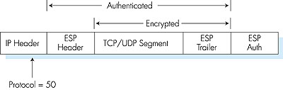
ESP Protocol
Provides secrecy, host authentication, data integrity.
Data, ESP trailer encrypted.
Next header field is in ESP trailer.
ESP authentication field is similar to AH authentication field.
Protocol = 50.

Slide 53

Authentication Header (AH) Protocol
Provides source host authentication, data integrity, but not secrecy.
AH header inserted between IP header and IP data field.
Protocol field = 51.
Intermediate routers process datagrams as usual.
AH header includes:
connection identifier
authentication data: signed message digest, calculated over original IP datagram, providing source authentication, data integrity.
Next header field: specifies type of data (TCP, UDP, ICMP, etc.)

Slide 54
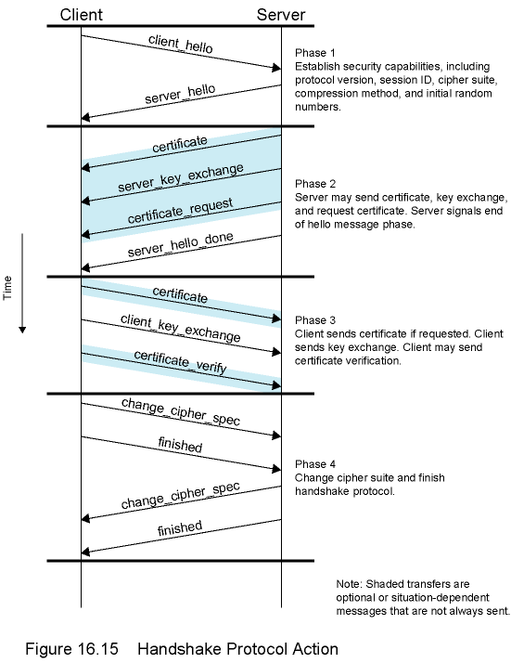
Sample Handshake
Protocol Action

Slide 55
Network Security (summary)
Basic techniques…...
cryptography (symmetric and public)
authentication
message integrity
…. used in many different security scenarios
secure email
secure transport (SSL)
IP sec

